Slide 1
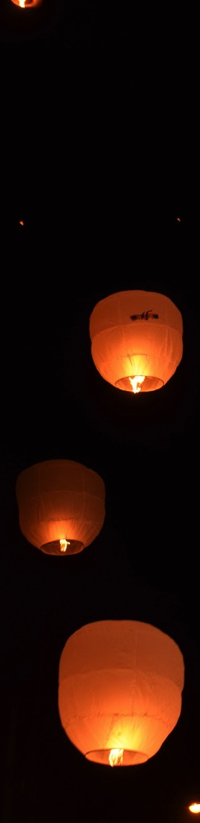
[verse, bridge or chorus marker – 14 or 18 size font]
[Song title – 48 font size]
[lyrics go here]
[32 font size minimum – aim for 36]

